Slide 2
Apple iOS Zoom App -
https://apps.apple.com/us/app/zoom-us-cloud-
video-meetings/id546505307
Android Zoom App -
https://play.google.com/store/apps/
details?id=us.zoom.videomeetings

Slide 12
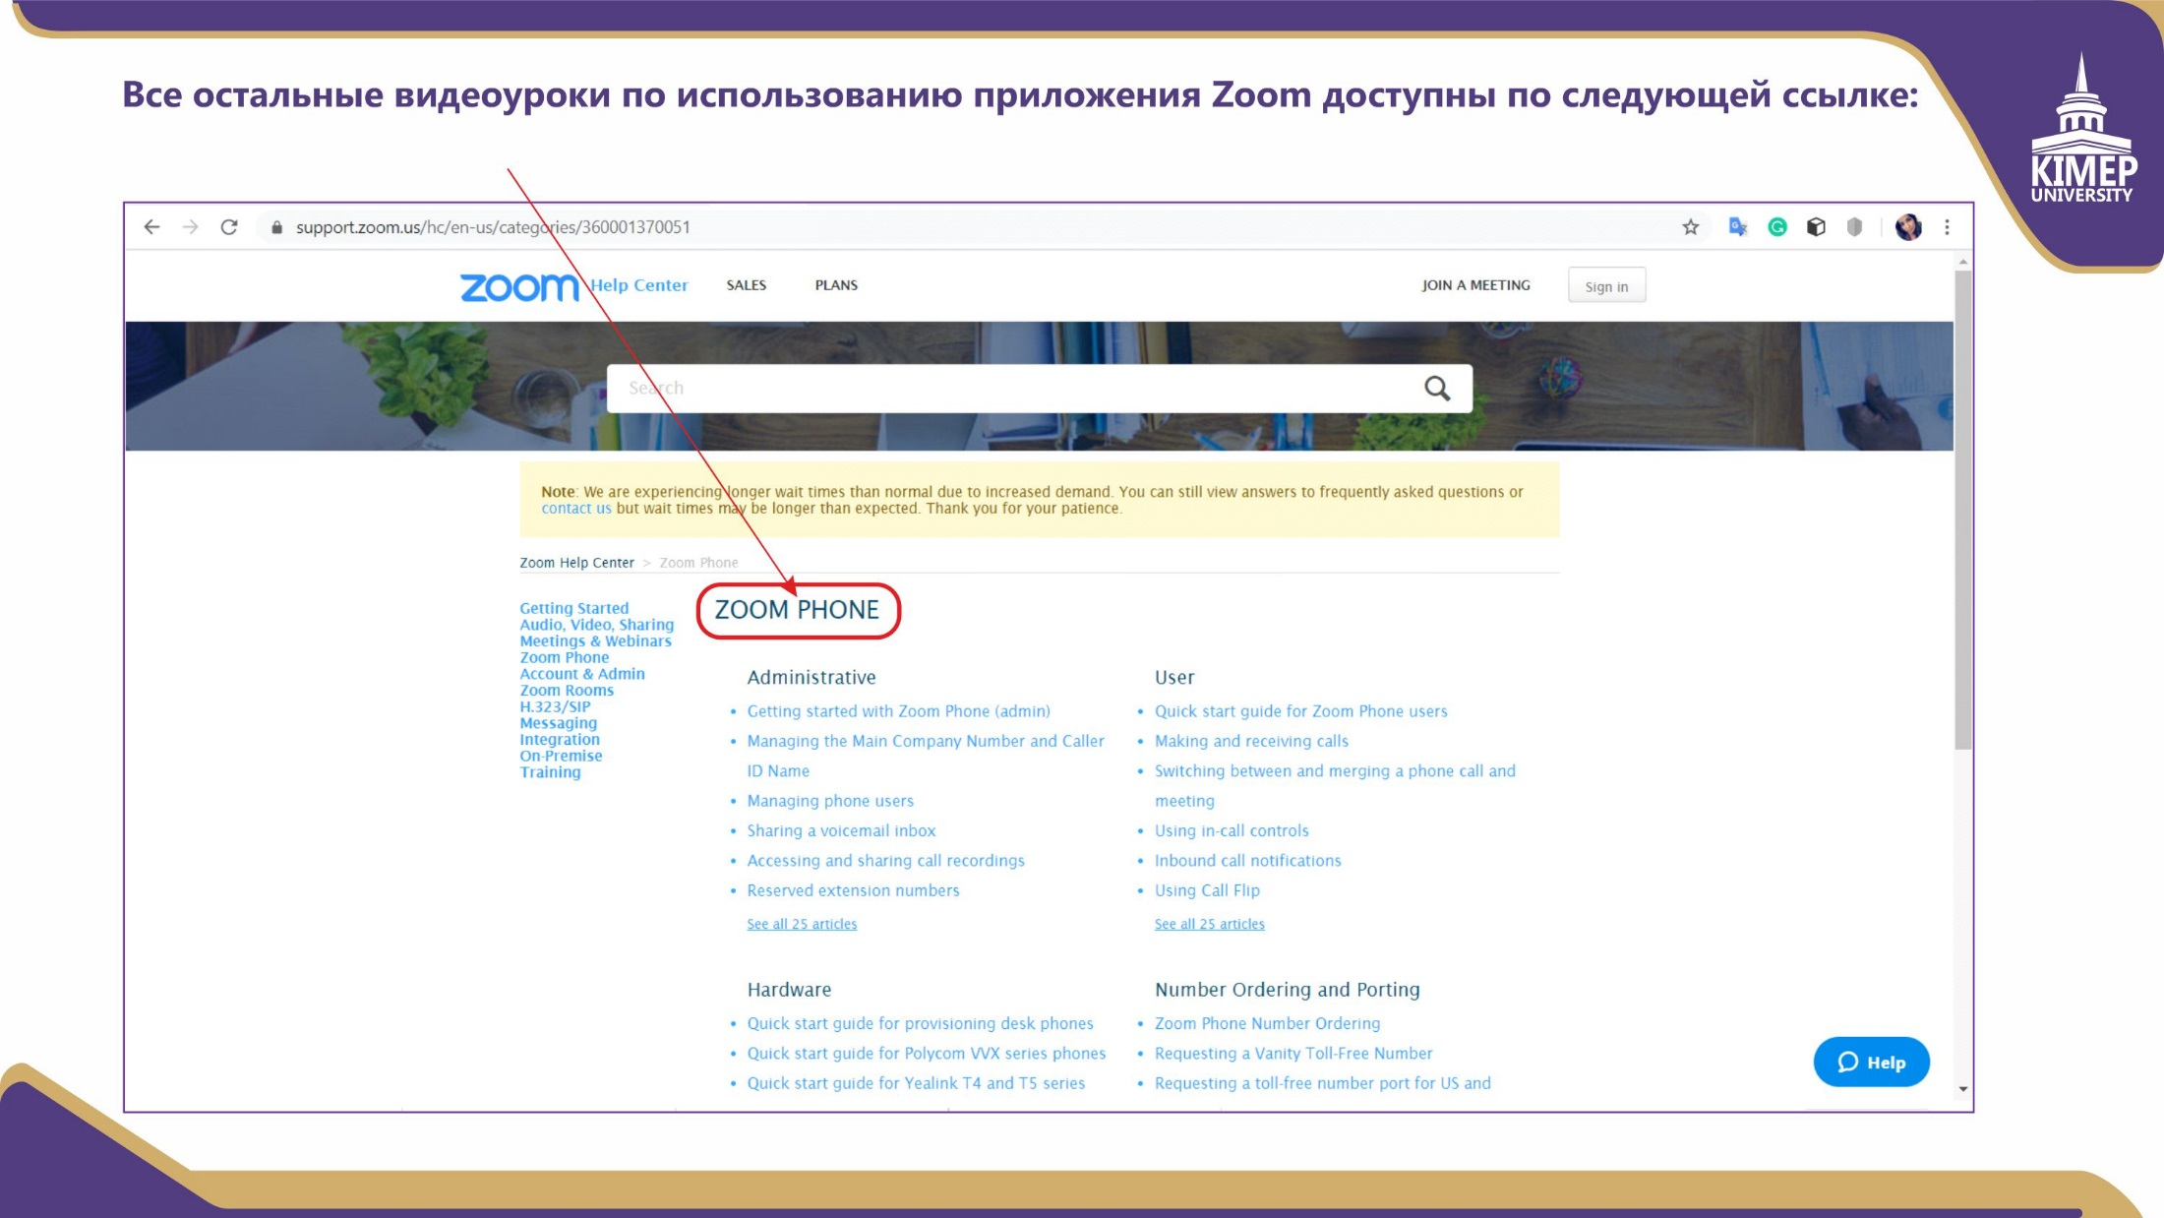
https://support.zoom.us/hc/en-us/categories/360001370051

