Slide 5
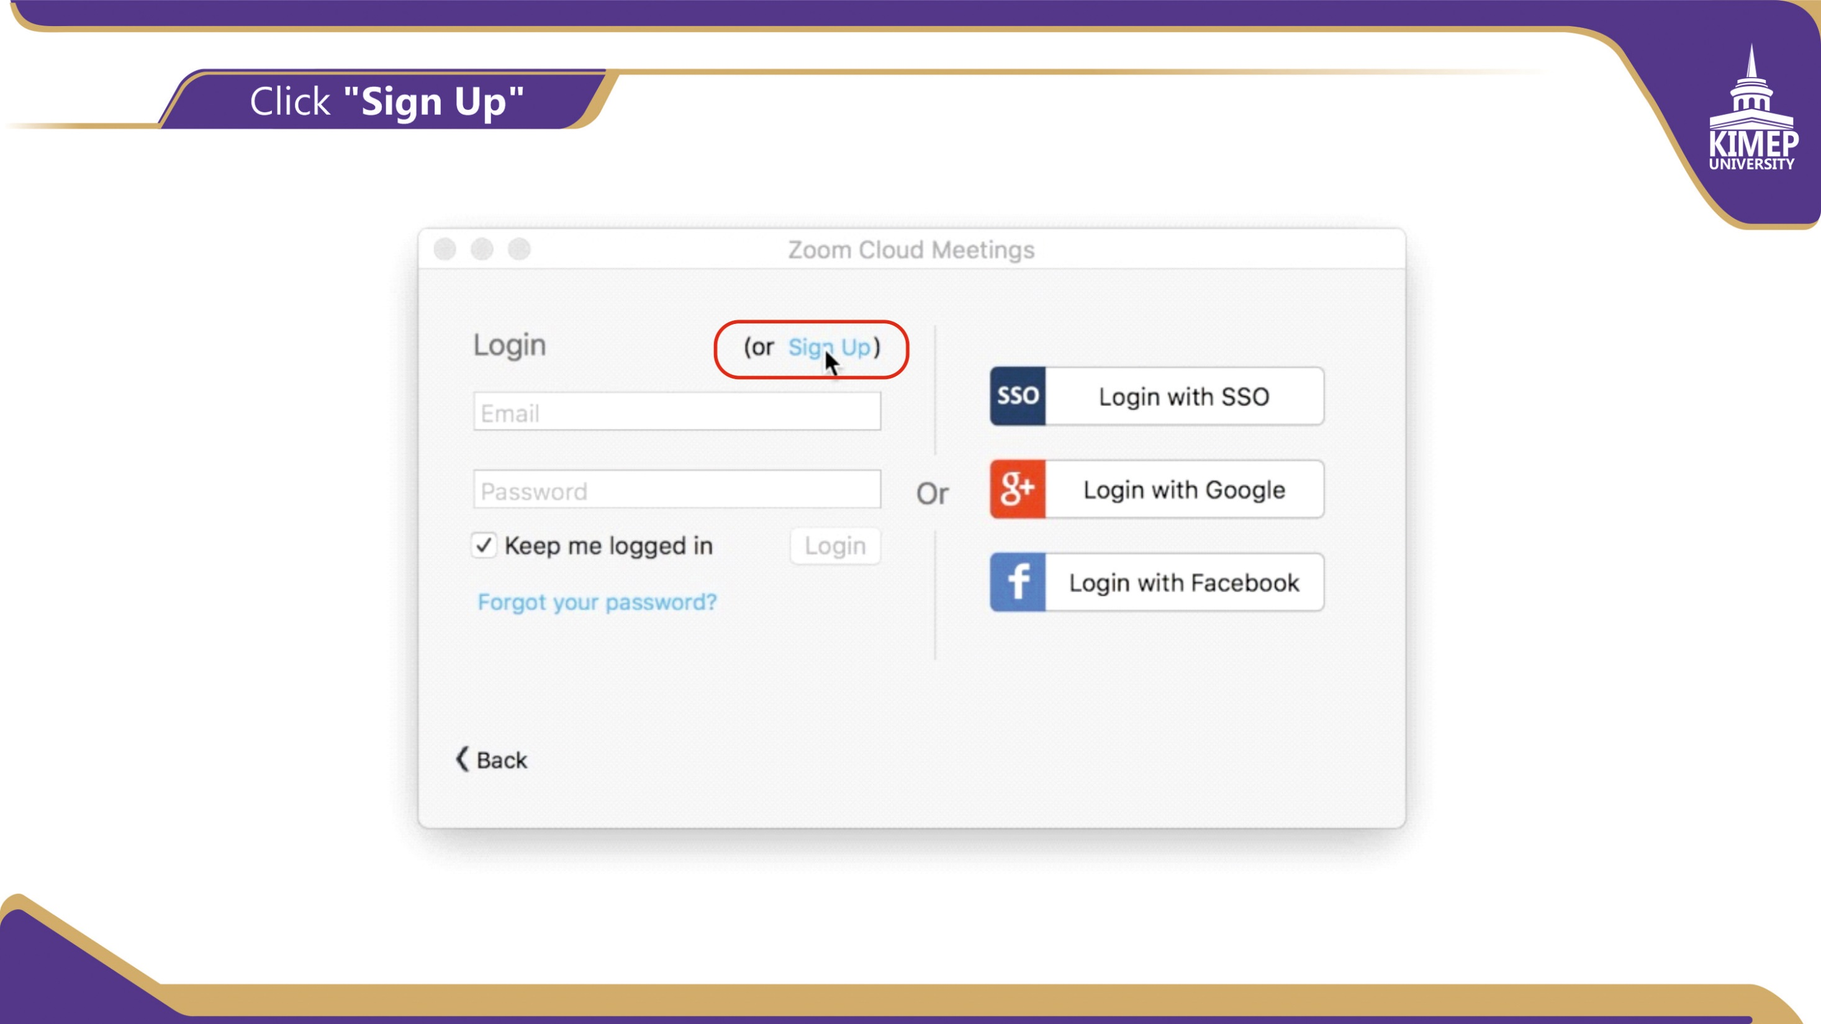

Slide 6
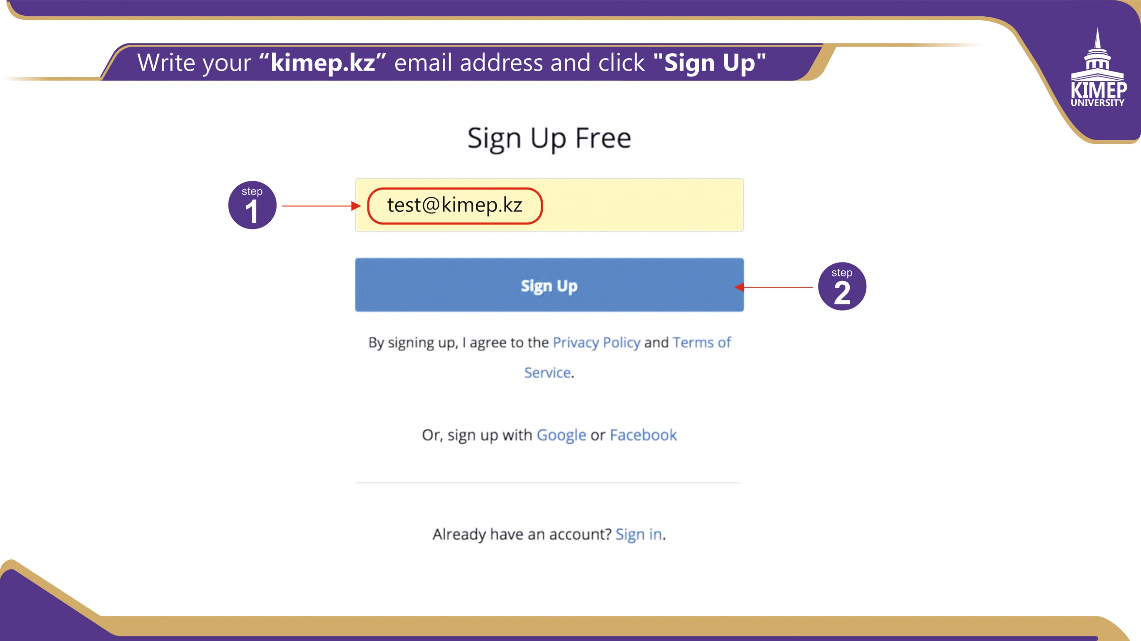

Slide 16
https://support.zoom.us/hc/en-us/articles/206618765-Zoom-Video-Tutorials

